Slide 1



ITC - 6460 CLOUD ANALYTICS
Winter 2020| CRN: 21261
FINAL ASSIGNMENT : Analysis of Student move-in issues using AWS cloud services
GROUP EPSILON :
ASHWIN NAIR
RISHABH TANEJA
SINDHU SIDDALINGAMURTHY
AKASH SINGH

Slide 2
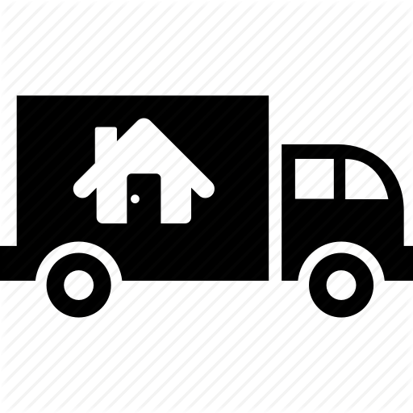
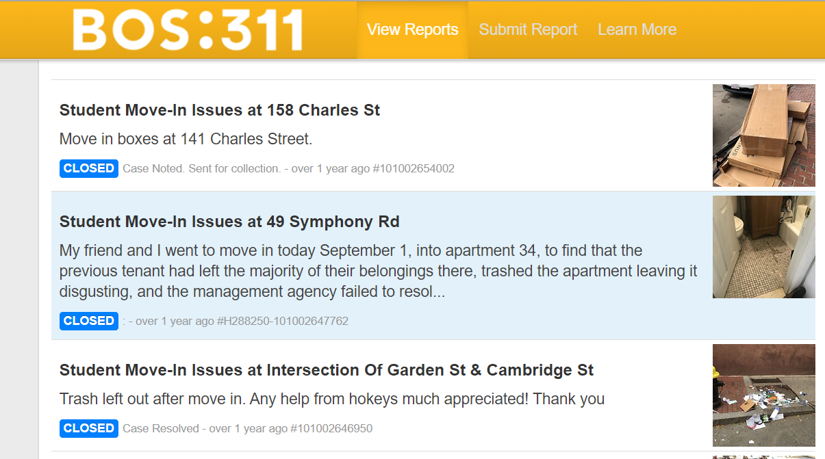
Abstract
The Design of an architecture was based on the data collected from https://311.boston.gov wherein the customer complaints were recorded for the issues in and around the area. The data scraped were images and we used the serverless Amazon Cloud infrastructure. We gathered the dataset using python scripts via Amazon CLI and compiled the images to build a solution for the project.

Slide 3

Scope
To visualize and gather insights about materials left on the streets by students - Scraping the 311 reports and performing object detection for all images from the “Student Move-in” section of Bos 311 reports.
We wrote a code on Spyder (Python 3.7) to penetrate every page that exists under “Student move-in’ to pick images in jpg format and store in on our desktop. We first used Beautiful Soup function to parse the Html page on Boston 311. However, it seems like the Bos 311 server has all the images on their private server and we had to prefix ‘https://311.boston.gov?page= on every iteration.

Slide 4

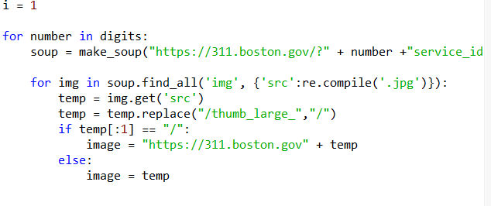
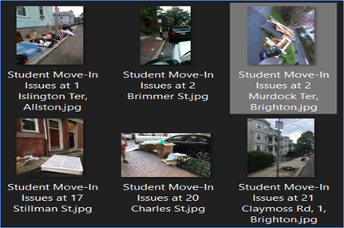
Data Preparation
We scrapped the data using beautiful soup package using a lambda function
Collected all the .jpeg files onto the local system
Used Command line feature to transfer the files from local disk to s3

Slide 5
AWS SERVICES USED
AWS Lambda -Lambda function getobjects() the data from Amazon’s S3 and then places it on to the AWS Rekognition using the detect_label() API call which has been made and accepts only .jpeg and .png format files.
Simple Storage S3 - stored the images by scraping the 311boston webpage using Python and Beautiful Soup library
AWS Rekognition - Used the API detect_label() and boto3 library which provides the AWS services functionality. We did run a loop via lambda function using Python to get the images from S3 and provide it as an input to Rekognition
Quicksight – Uploaded the json/csv files and created visualizations to derive actionable insights

Slide 6
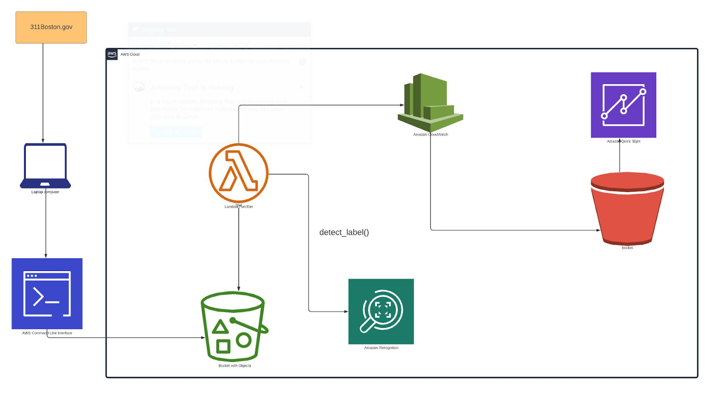

Cloud Service Architecture

Slide 7
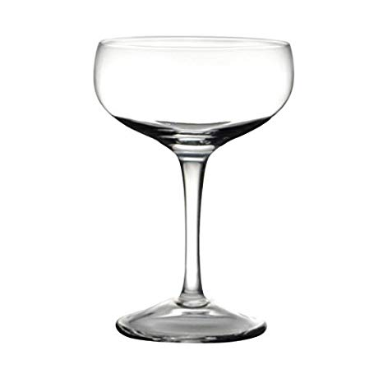
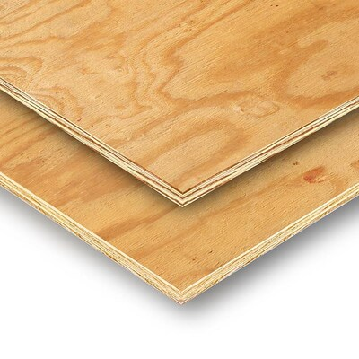
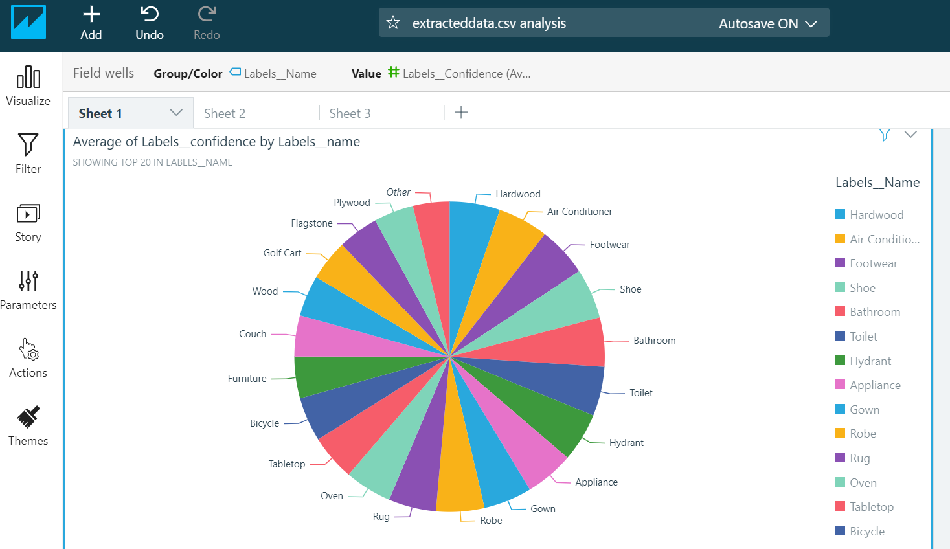
Data Analysis
Furniture & Wood are the main types of materials left out on the streets
Plywood and Cardboard are the most frequent items seen
Carton , Bags , Chairs & Glass are also seen in a high numbers

Slide 8
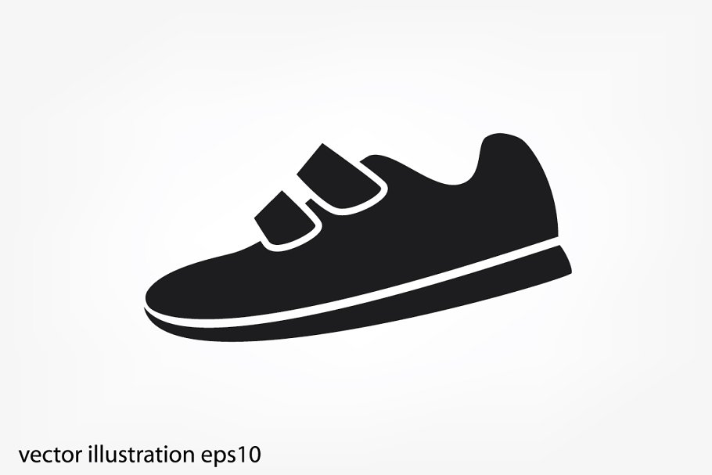

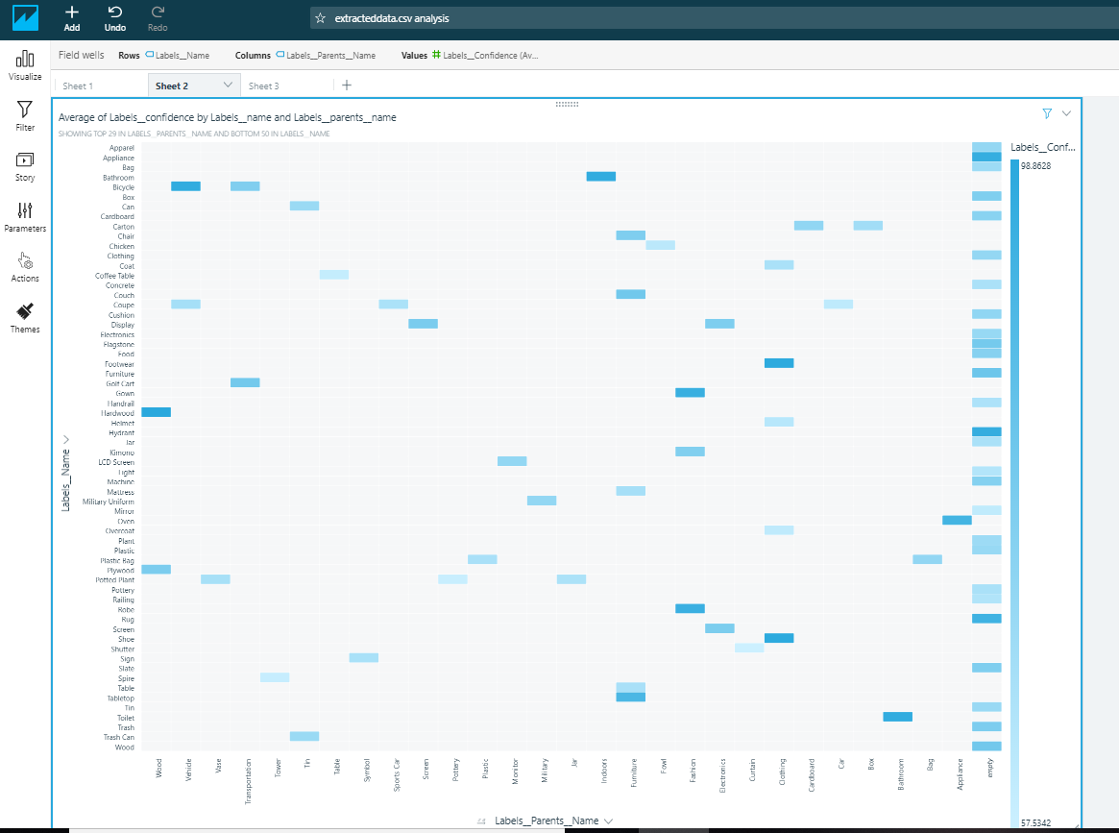
Data Analysis- II
Categorizing the label parent name as x axis, we show how each label name is varying in confidence level.
Hardwood shows the highest confidence with 98.8%
‘Shoes’ seem to show a confidence level of 97.9%

Slide 9


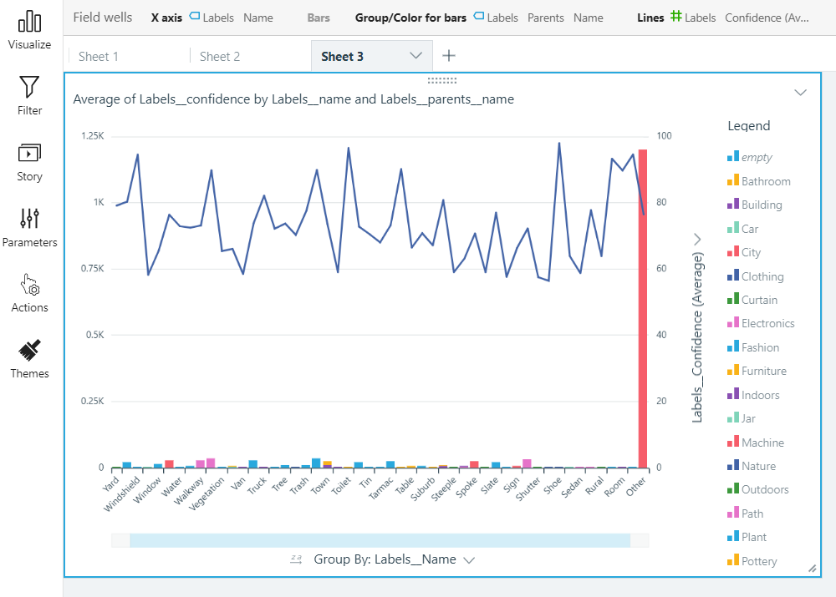
Data Analysis - III
This visual gives a better idea of the label names, the count and the confidence level as detected.
There are clothing material – leather, rugs and coupe glass that are common

Slide 10
Roadmap for Improvements
Textiles, mattresses and bedding shouldn’t be thrown away – connect with local charities and MassDEP Beyond the Bin Recycling Directory can be used to find nearby drop-off locations
Any wood or metal products are recycled by Wood Waste of Boston Inc for energy production. Understand the feasibility of them opening a facility near Northeastern
Glass cannot be recycled with other products and its around 70% of glass is recycled back into shelves within 30 days. Earth911 provides a directory of redemption centres for glass aroud Boston.

Slide 11
References:
https://311.boston.gov/
https://aws.amazon.com/qi
https://www.bostonbuildingresources.com/advice/recycling-where-does-it-all-go
https://www.boston.gov/
https://docs.aws.amazon.com/cli/latest/reference/s3/cp.html
https://boto3.amazonaws.com/v1/documentation/api/latest/guide/quickstart.html#using-boto-3
https://www.crummy.com/software/BeautifulSoup/
https://www.python.org/

Slide 12


ANY QUESTIONS
Nair.as@husky.neu.edu
Singh.akash@husky.neu.edu
Taneja.ri@husky.neu.edu
Siddalingamurthy.s@husky.neu.edu

Slide 13
THANK YOU

